Slide 1


DEPARTMENT OF ELECTRICAL AND ELECTRONICS ENGINEERING
18ECP103L - MINOR PROJECT 1
LED DISTANCE INDICATOR
BATCH NO:37
PRESENTED BY:
S.RAGAVI [927621BEC159]
S.REENA[927621BEC164]
S.SARANYA[927621BEC186]
GUIDE:
Dr.A.KAVITHA
PROFESSOR-ECE

Slide 2
LIST OF CONTENT
Objective
Abstract
Introduction
Working Principle
Applications
Simulation diagram
References

Slide 3
OBJECTIVE
It is handy system for non-contact measurement of distance. The device calculates the distance with suitable accuracy and resolution. It is better than parallax's PING sensor that can able to detect object in range 3 metre

Slide 4
ABSTRACT
Ultrasonic sensor is one of most popular sensor types to be used in distance measurement.
This sensor generates sound waves to measure the distance between itself and the measurement object by using the calculated time of the waves when the waves are reflected back to the sensor

Slide 5
INTRODUCTION
Build and code a circuit to control the color of an LED using a distance sensor.
If an object is less than 20 cm close to the distance sensor, the LED will be red, but if the object is over 20 cm far from the distance sensor then the LED will be green.

Slide 6
PROBLEM IDENTIFICATION
The speed of sound is variable in different mediums & also depends on temperature of the medium, so manual manipulations are required on calculated distance.
The ultrasonic sensor are inflexible scanning.
The size of the object should be of the order of wavelength of signal for it to be detected. So object should not be very small.
The object should be placed near the rotational axis of transmitter. At wider angles less reflection takes place.
The object should be a good reflecting surface.

Slide 7
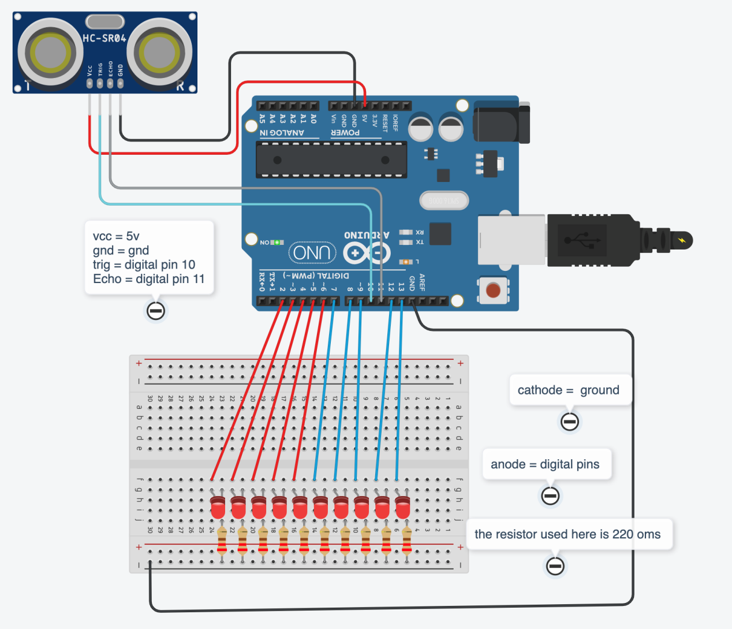
CIRCUIT DIAGRAM

Slide 8
COMPONENTS DETAILS
MATERIALS:
2 LEDs (1 green and 1 red)
2 Resistances 220
1 Ultrasonic sensor (distance sensor)
1 Build & Code UNO board
1 Proto board

Slide 9
LED
A LED is a light-emitting diode and it emits light when electricity passes through it.
It has an Anode and a Cathode. The anode is the positive side and the cathode is the negative side.
You can distinguish between the anode and the cathode by looking at its legs. The larger leg is the anode and the shorter leg is the cathode.
The electricity can only pass through in one direction, from the anode to the cathode.

Slide 10
ULTRASONIC SENSOR
The purpose of ultrasonic sensor is to measure the distance using ultrasonic waves.
Ultrasonic sensor emit the ultrasonic waves and receive back the reflected .
So, by this time the ultrasonic Sensor will measure the distance to the object . It can sense from 2-400cm

Slide 11
UNO BOARD
One of the most popular Arduino boards out there is the Arduino Uno. While it was not actually the first board to be released, it remains to be the most actively used and most widely documented on the market.

Slide 12
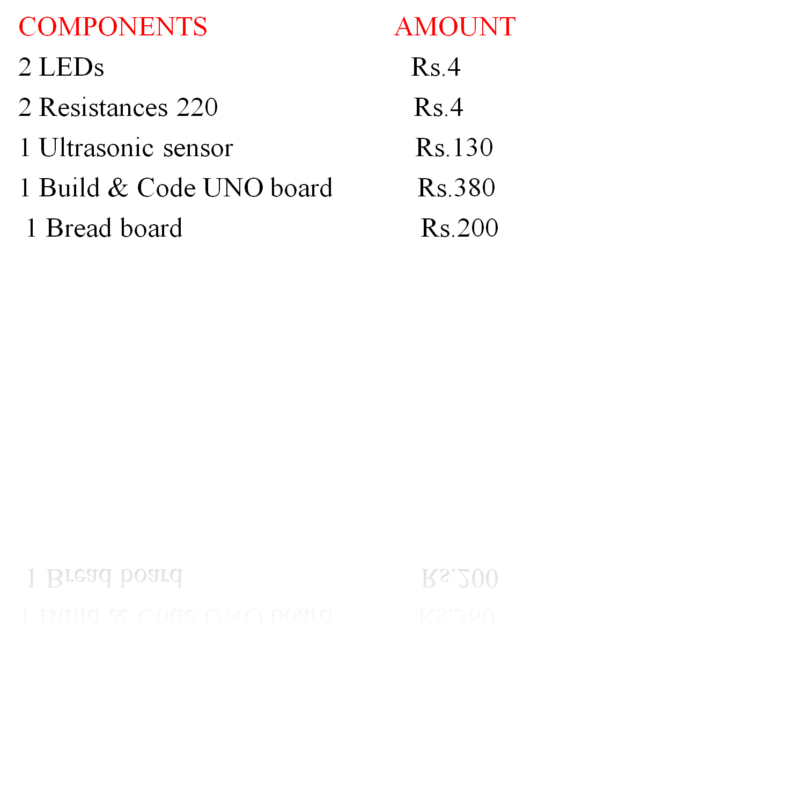
COMPONENTS BUDGETS

Slide 13
WORKING PRINCIPLE
The ultrasonic sensor (or transducer) works on the same principles as a radar system.
An ultrasonic sensor can convert electrical energy into acoustic waves and vice versa. The acoustic wave signal is an ultrasonic wave traveling at a frequency above 18kHz.
Typically, a microcontroller is used for communication with an ultrasonic sensor
To begin measuring the distance, the microcontroller sends a trigger signal to the ultrasonic sensor.
The duty cycle of this trigger signal is 10µS for the ultrasonic sensor. When triggered, the ultrasonic sensor generates eight acoustic (ultrasonic) wave bursts and initiates a time counter.

Slide 14
APPLICATIONS
Thus, this is all about the distance sensor or proximity sensor.
Detecting components & parts Observing stack heights, detection of the double sheet, measurements of height within the wood, handling & packaging industries .
These sensors are used for accurate and fast measurement, exact positioning as well as an extensive range of materials detection
These sensors are consistent tools used for numerous applications like checking of unwinding coils, detection of the double sheets

Slide 15
SCOPES
This is a very economic technology and can be used in several other fields as well, few are listed as below:
1. Can be used as parking assistance systems in vehicles with high power ultrasonic transmitter.
2. Can be used as burglar alarm with suitable additional software for homes and offices.
3. Can be a used in liquid level measurement.
4. Can be used to find breakdowns in wires or thread

Slide 16
REFERENCES
Methiphiwat, Factors Affecting the Use of Bank Account Payments for Residents of Residents in Water Housing Case Study, Nonthaburi Provincial Waterworks Authority, Public Management Program College of Commerce
M. Khaostiwong, Student Ethics as Perceived by Students Teachers and parents of Chiang Mai University Demonstration School Educational Psychology and College Counseling Program, Chiang Mai University, 2008.
"RGB and CMYK are different and are suitable for any type of design September 2017.

